Slide 1
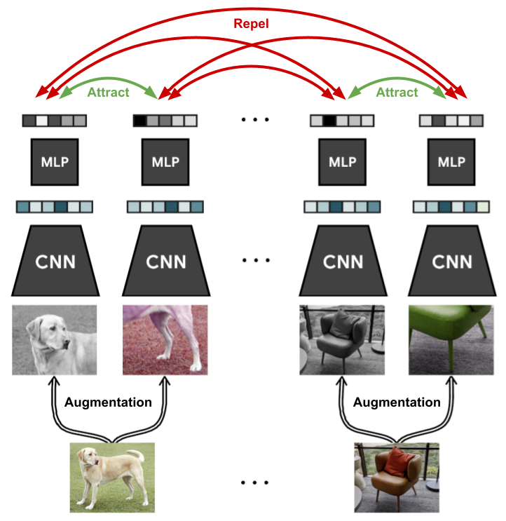
A Simple Framework for Contrastive Learning of Visual Representations (SimCLR)
SimCLR is a self-supervised learning (SSL) method that learns useful image features without using labeled data.
The model learns by comparing different augmented versions of the same image and recognizing that they belong together.
Similar images → representations should be close
Different images → representations should be far apart

Slide 2
What is Self-Supervised Learning (SSL)?
SSL learns useful features without using labels first
The model creates its own learning task
Helps learn patterns from large image datasets
Useful for medical images like brain MRI

Slide 3
Why SSL for Brain MRI?
MRI images contain important texture and structure
Medical labels are often limited or expensive
SSL learns representations before classification
Helps models understand brain scan patterns

Slide 4
SimCLR
Uses two augmented views of the same image
Positive pair: two versions of the same MRI
Negative pairs: images from other samples
Learns similarity between related images
Simple Diagram:
Original MRI
|
|----> Augmented View 1 ----> Encoder ----> Vector A
|
|----> Augmented View 2 ----> Encoder ----> Vector B
Goal:
Vector A ≈ Vector B
Other images → far away

Slide 5
BYOL (Bootstrap Your Own Latent)
Uses two augmented views of the same image
Online network learns from a target network
No explicit negative pairs required
Works well when images are visually similar
Diagram:
Original MRI
|
|----> View 1 ----> Online Encoder ----> Predictor ----> Output A
|
|----> View 2 ----> Target Encoder --------------------> Output B
Goal:
Output A ≈ Output B

Slide 6
MAE (Masked Autoencoder)
Splits image into patches
Many patches are hidden
Model predicts missing patches
Learns spatial structure of image
Diagram:
Original MRI
|
Split into patches
|
Mask many patches
Visible patches → Encoder → Decoder → Reconstructed Image

Slide 7
Why These Three Methods?
SimCLR: contrastive learning
BYOL: teacher–student learning without negatives
MAE: reconstruction-based learning
Covers three major SSL approaches

Slide 8
Application to Brain MRI
SimCLR learns visual similarity
BYOL learns stable representations
MAE learns spatial understanding
Useful before tumor classification

Slide 9
References
•Chen et al., 2020 – SimCLR
• Grill et al., 2020 – BYOL
• He et al., 2021 – MAE

